Slide 1

Development of Smart Waste Management System based on IoT platform

Slide 2


Mini Project By:
SHIVA SAI(18BEC012)
KIRAN D(18BEC022)
NIKHIL S A(18BEC033)
NITHIN R(18BEC034)
Project Guide:
Dr. Prakash Pawar

Slide 3
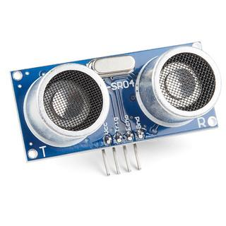
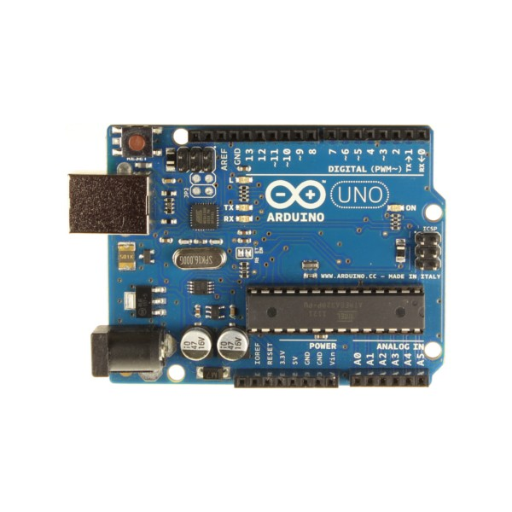
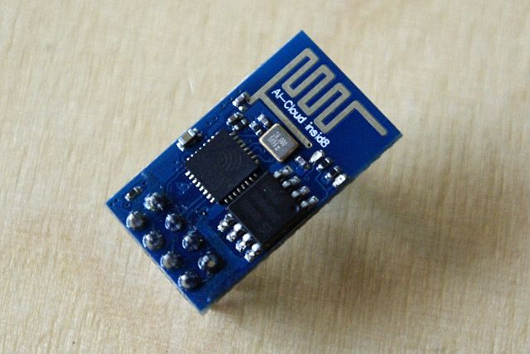

Hardware Development
We are developing a hardware which collects data from sensors and send it to cloud.
Ultrasonic Sensor data ---> Arduino Uno ---> ESP8266 Wireless Transceiver module ---> Thingspeak cloud.
---> ---> --->

Slide 4
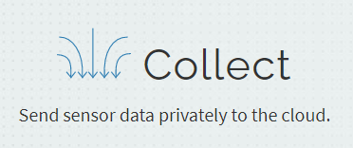
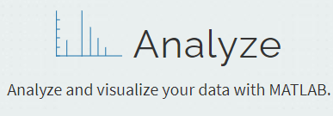
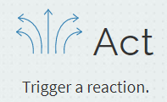
About Thingspeak cloud
ThingSpeak is an IoT analytics platform service that allows you to aggregate, visualize, and analyze live data streams in the cloud. You can send data to ThingSpeak from your devices, create instant visualization of live data, and send alerts.

Slide 5
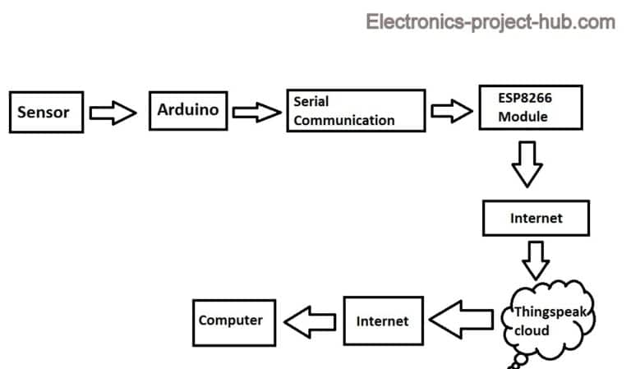
Block Diagram for Ultrasonic sensor Data to Thingspeak

Slide 6
Firstly the Arduino will trigger the ultrasonic sensor and collects the data, after calculating the distance arduino will convey this data to ESP8266 module via UART / serial communication. The serial data consists of distance data in cm with 2 to 3 decimal places. The ESP8266 will send this data to your Thingspeak account via internet.
Since we are using a generic ESP8266 module we have to upload an appropriate program code that makes ESP8266 to accept serial data and send it to Thingspeak. We also need to upload another program code to Arduino board, so that it will convert the measured ultrasonic sensor data in serial data.

Slide 7
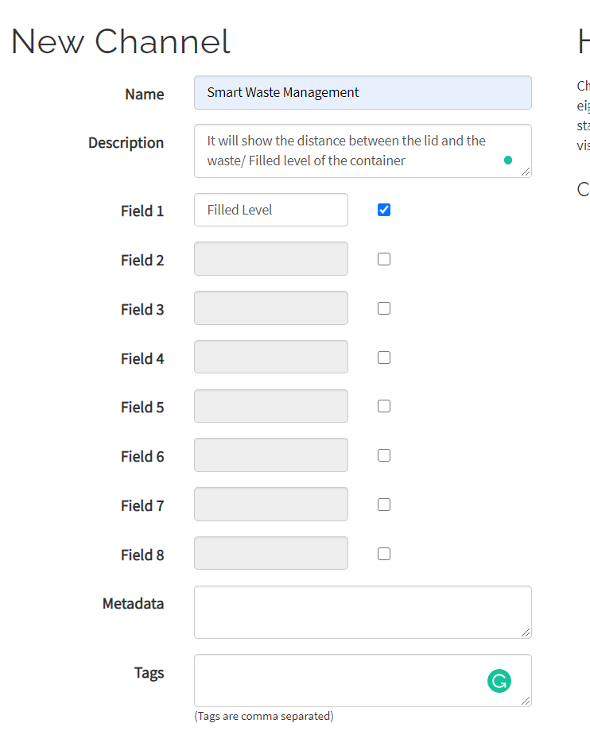
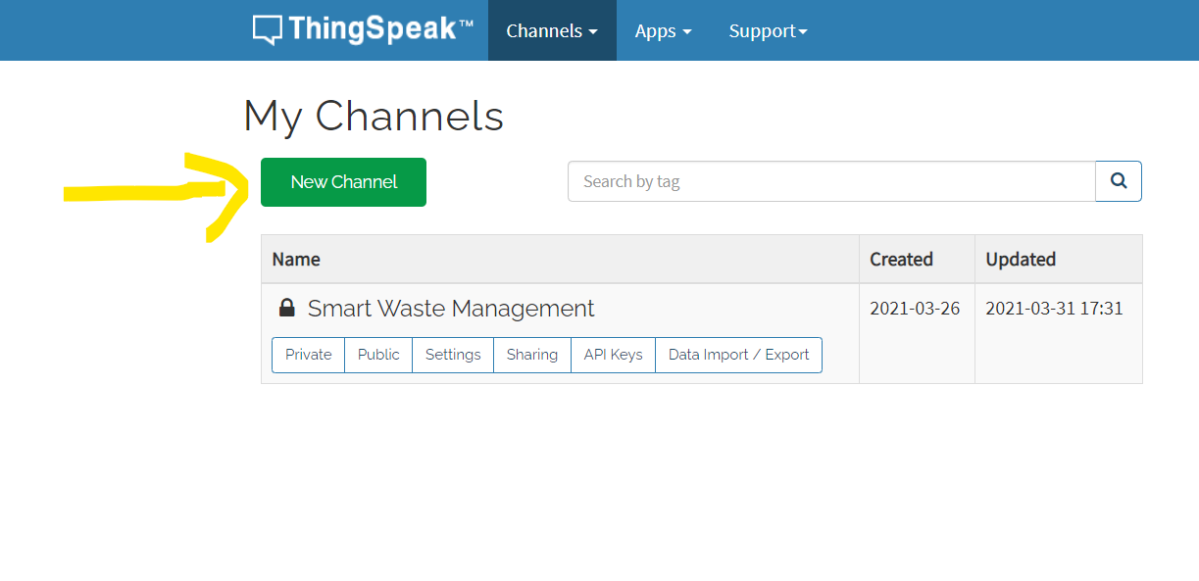
Creating Thingspeak channel

Slide 8
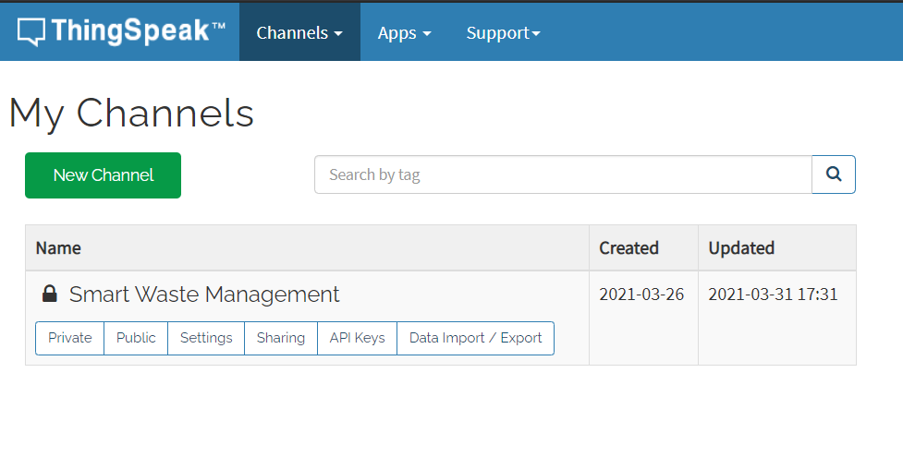
After successfully creating the channel it looks like this

Slide 9
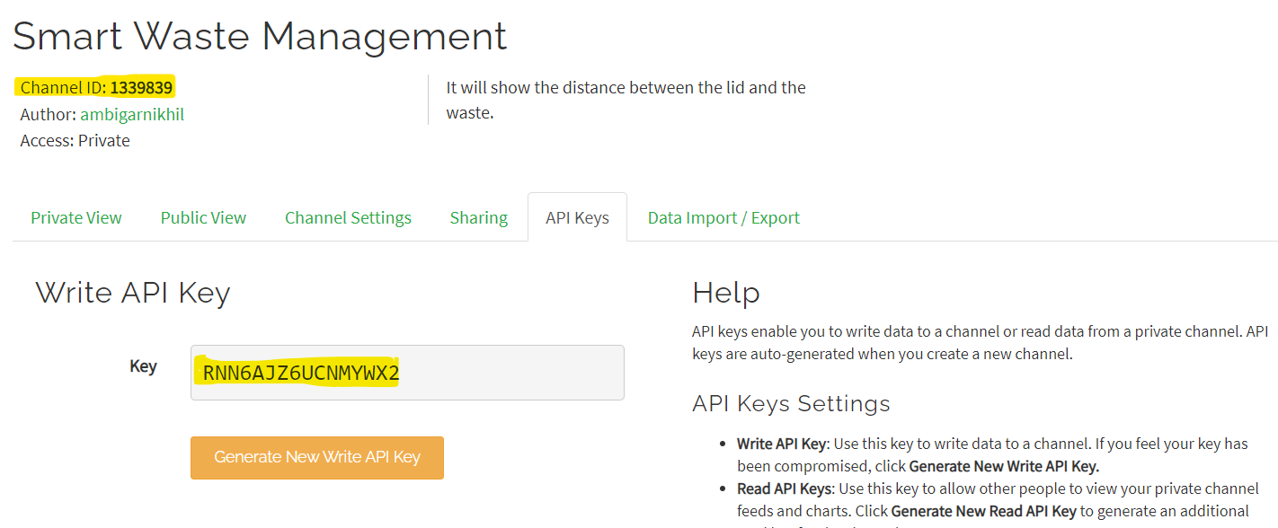
After creating we need to copy channel id, and write api key as we need it for programming esp8266 module.

Slide 10
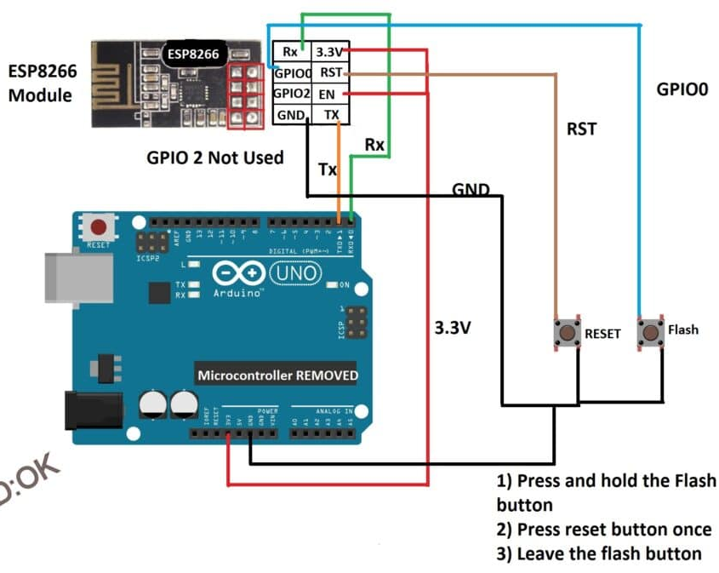
How to upload the program code to ESP8266 module.
We need to wire up the circuit as shown in the image.
*ESP8266 works on 3.3V and 5V will kill your module.

Slide 11
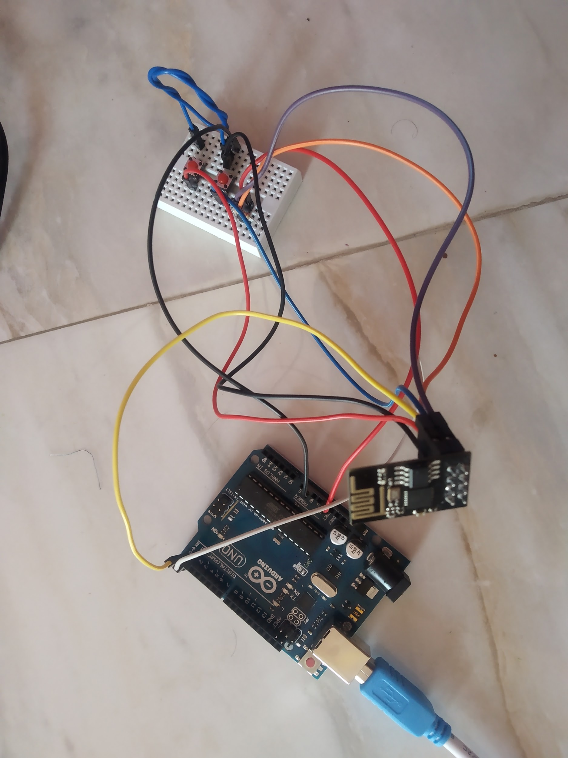
Once we wire-up it will look something like this:
Press and hold the flash button now press the reset button once and leave the flash button. Pressing buttons in reverse sequence or pressing in some other way will results in fail to upload the program code.
Then select the board as generic ESP8266 on your IDE.
Select 9600 as baud rate and select the correct COM port.
Then click the upload button, it will take couple minutes to compile and another one minute to upload the code.
Once we successfully upload this code to ESP8266, we need to rewire and upload another code to Arduino board.

Slide 12
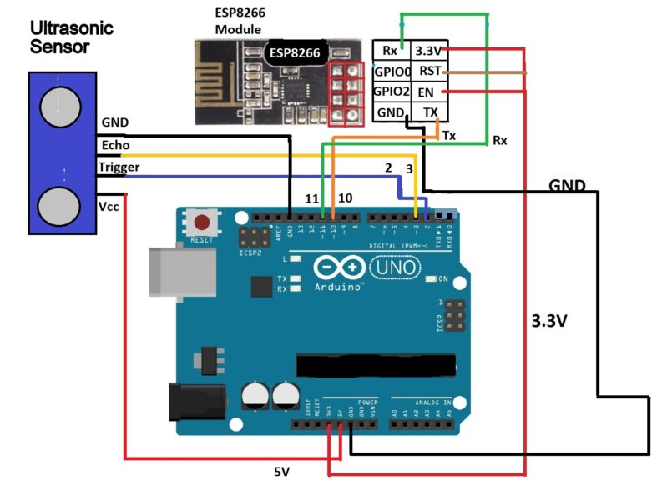
Uploading the program code to Arduino Uno.
We need to wire up the circuit as shown in the image.

Slide 13
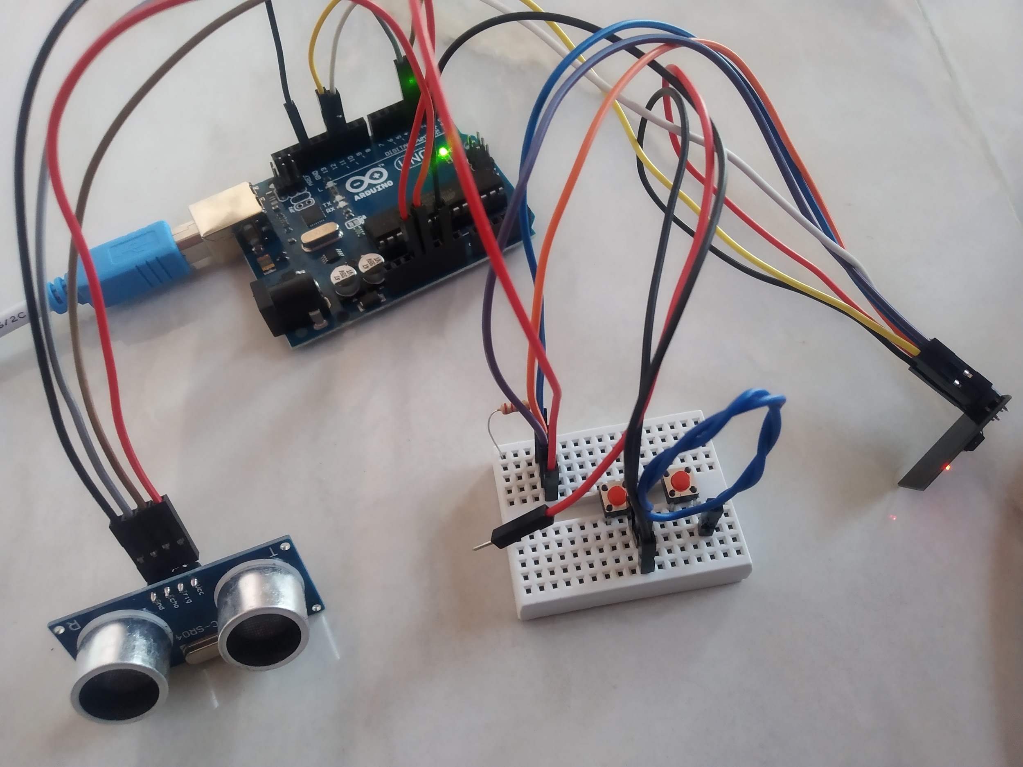
Once we rewire it will look something like this:
After uploading the code to Arduino board, We should open the serial monitor at 9600 baud rate to see the measurement and open the thingspeak channel to see the incoming data on Thingspeak.

Slide 14
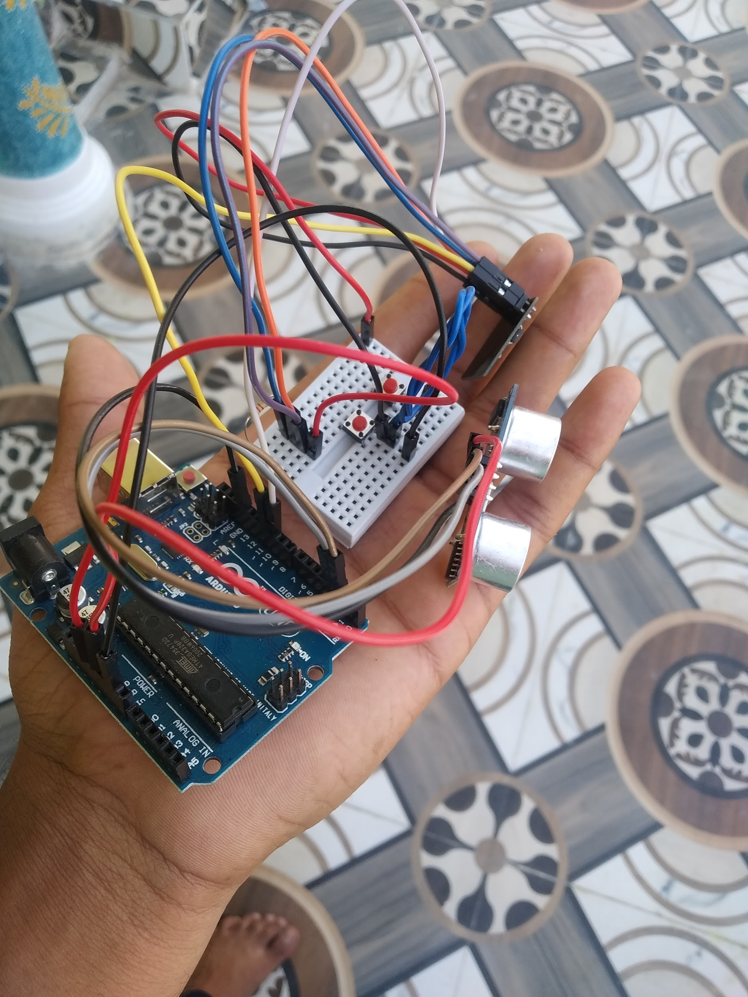
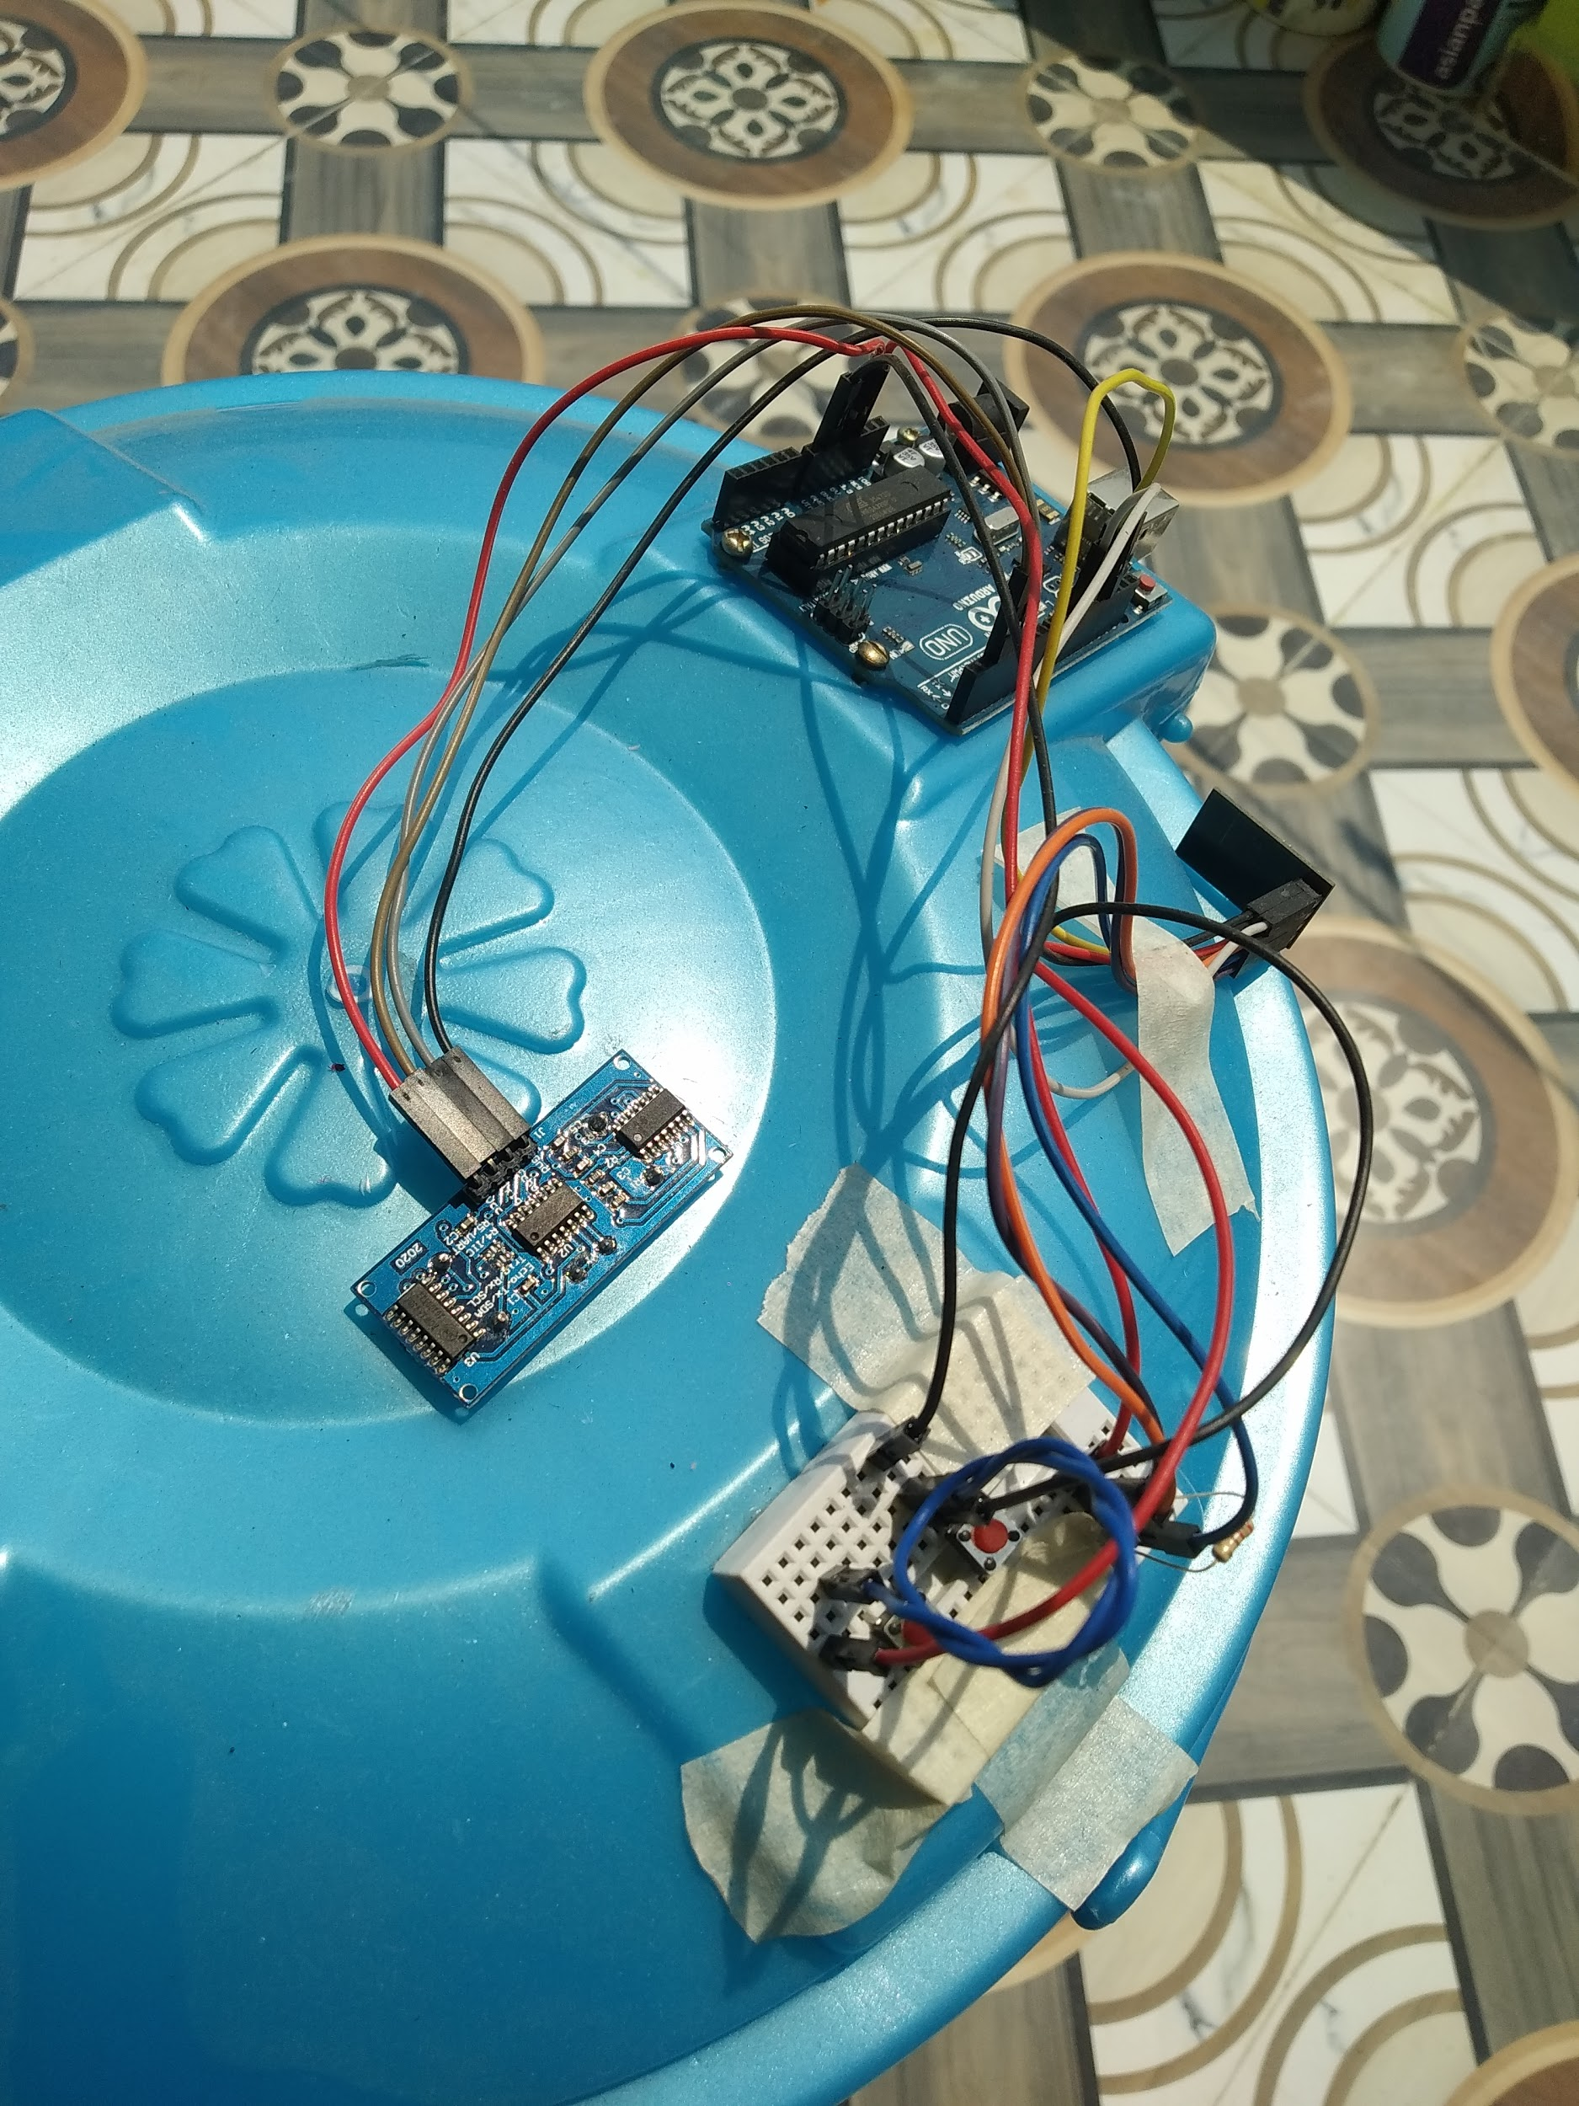
For demo purpose we fixed the module onto the small dustbin and checked its performance.

Slide 15
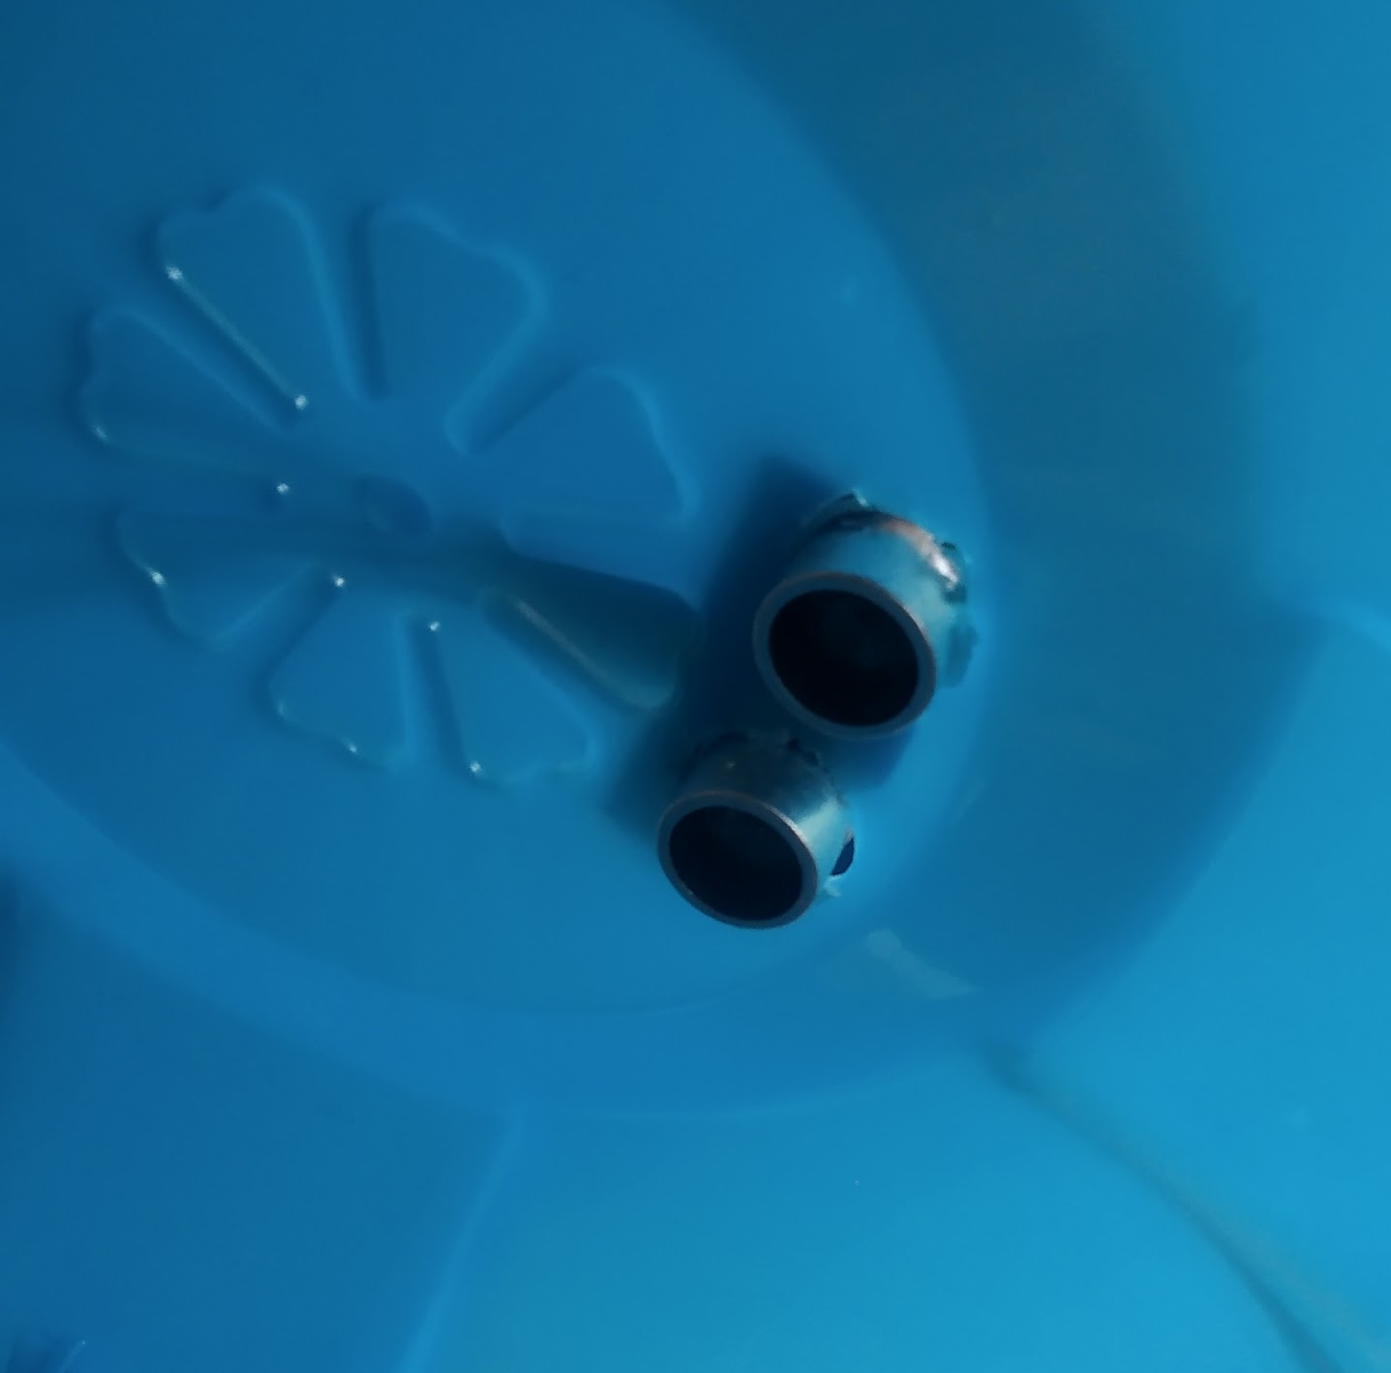
Interior view of the dust bin
Video link of channel creation in thingspeak:
https://youtu.be/ehq28VdjM8Y
Video link of uploading code to arduino uno:
https://youtu.be/OqIzo4FaqsA
Demonstration video link:
https://drive.google.com/file/d/1ZDDyE3r1UvYeT_7pusQywcre3h5chCBE/view?usp=sharing

Slide 16
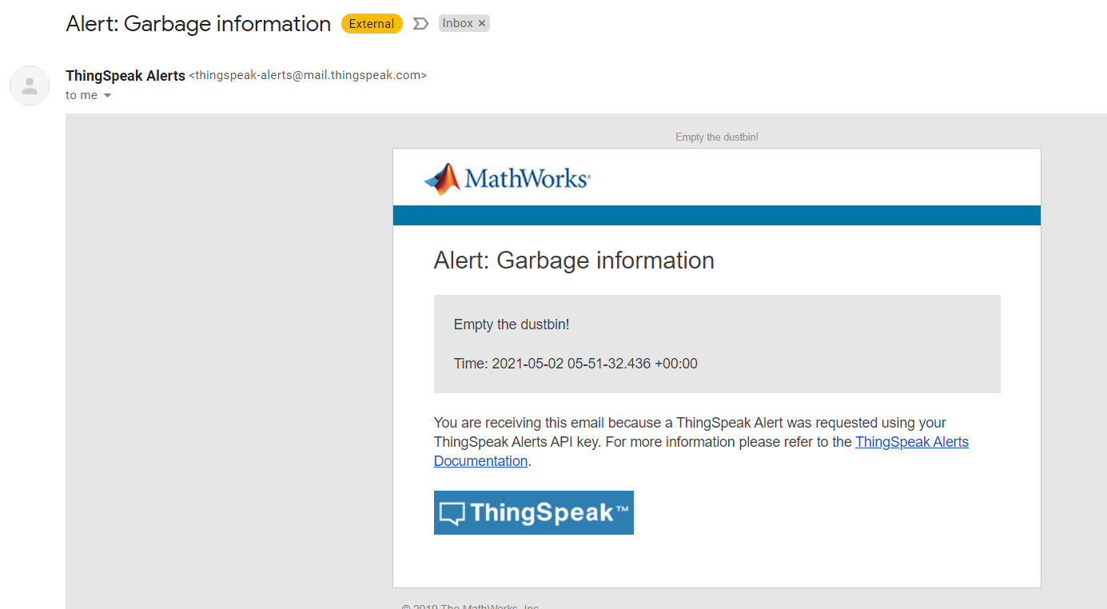
Alert mail on reaching threshold value:

Slide 17

Future Prediction

Slide 18
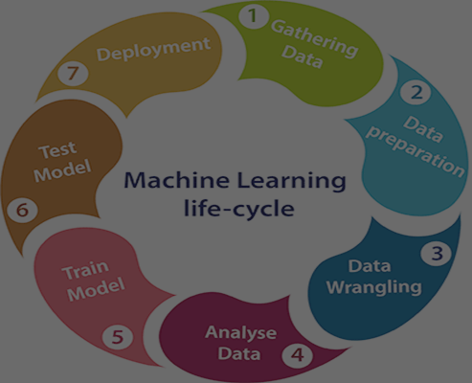
Steps for building machine learning model
Data Collection.
Data Pre-processing.
Choose a model.
Train the model.
Evaluate the model.
Make predictions.

Slide 19
Decision-Tree-Classifier
We are using Decision-Tree-Classifier for training the model. Decision Trees (DTs) are a non-parametric supervised learning method used for classification and regression.
The goal is to create a model that predicts the value of a target variable by learning simple decision rules inferred from the data features.
A tree can be seen as a piecewise constant approximation. DecisionTreeClassifier takes as input two arrays: an array X, sparse or dense, of shape (n_samples, n_features) holding the training samples, and an array Y of integer values, shape (n_samples,), holding the class labels for the training samples

Slide 20
